Slide 1












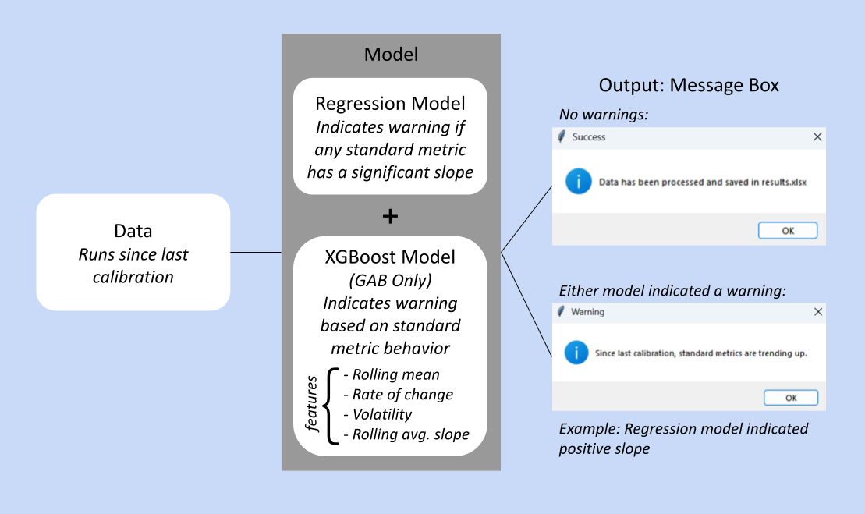
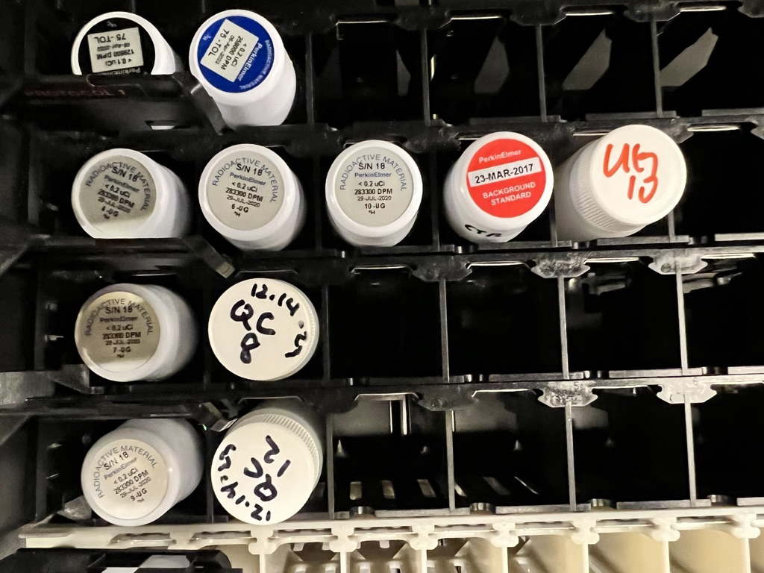
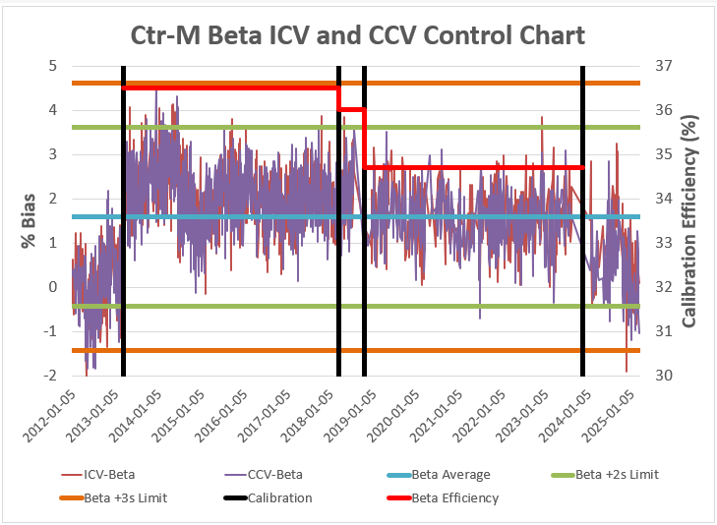
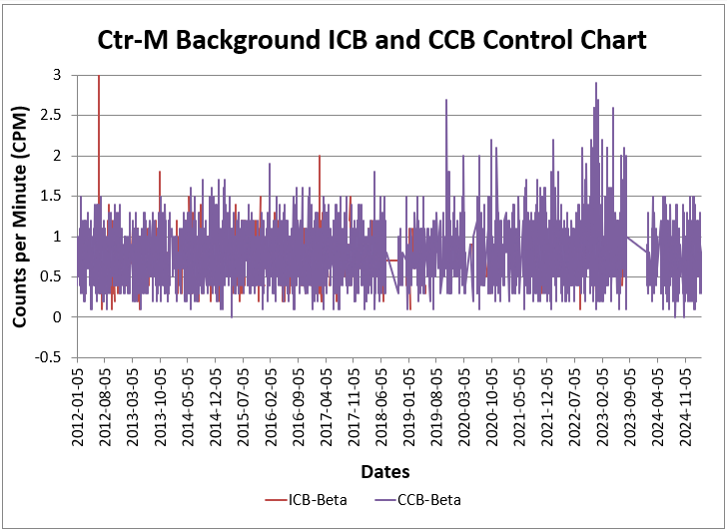
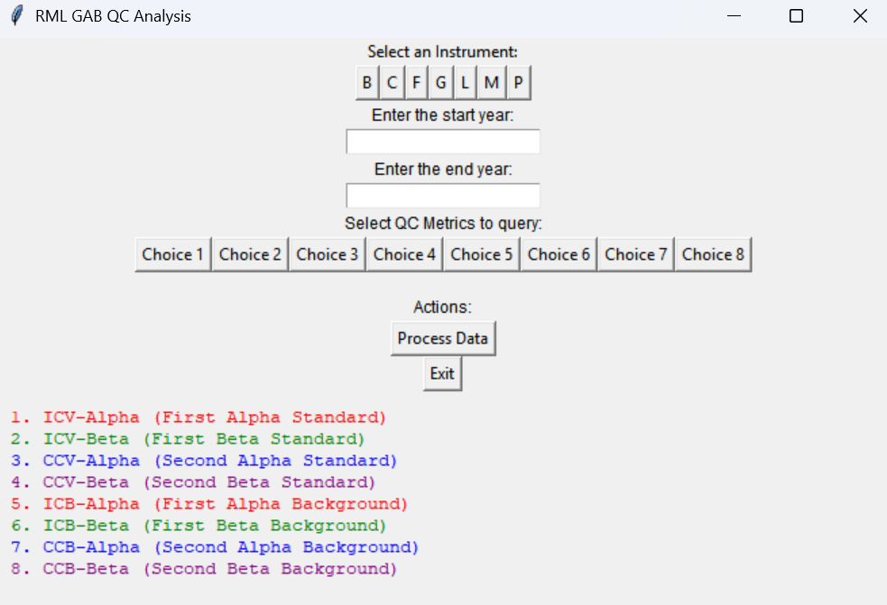



Radiological Measurements Laboratory QC Data Analysis
Carine Wong, Phil Torretto
NNSA-MSIIP, University of California – Davis, LLNL - Radiological Measurements Laboratory | wong153@llnl.gov
Introduction
Methods
Methods (cont’d)
In support of employee safety, Radiological Measurements Laboratory measures the presence of radioactivity around LLNL’s facilities
RML Gross Alpha Beta (GAB) and Liquid Scintillation (LSC) Counters measure radioactivity from air filters and swipes
Measurements are validated by Quality Control (QC) Sample readings and exported to plain text files
In this format, data cannot be visualized over time
Counters are required to be recalibrated every 2-5 years based on counter type
Recalibrations are done as-needed based on QC measurement behavior
RML counters have recently needed more frequent recalibrations
Run prediction model on runs since previous calibration → display a warning to user if model predicts need for recalibration
Regression + XGBoost (Extreme Gradient Boosting) Ensemble Model
Pull data from plain text files and store in tabular format
Iterate through .cal files, check if it has a converted .csv file in destination folder, and create one if not found
Generate Excel file of standard and background QC sample data:
Standards Metrics Data
Graph of Standards over time
Calibration data
Backgrounds Metrics Data
Graph of Backgrounds over time
Figure 4: Warning prediction model and example outputs
Figure 1: LSC QC Samples
Outcomes
Take user inputs from executable for specific machine, time frame, and QC Metrics to query
Iterate through .csv file folders for relevant files
Save relevant QC values to an Excel Sheet
The executables created allows us to visualize QC data over time and make data-driven decisions for instrument recalibrations, supporting employee safety and day-to-day lab activities.
Objectives
In response to a higher frequency of failed runs of RML counters, my project continued development of an executable that:
Pulls QC Sample measurements from individual runs and plots them over time
Aids in predicting upcoming needs for counter recalibrations
Acknowledgements
Special thank you to my mentor, Phil Torretto, for his unwavering support and guidance throughout my time here at LLNL.
Thank you to Mark Mitchell and our points of contact at ES&H for their help and input.
Thank you to the NNSA-MSIIP team for providing this invaluable opportunity for learning.
This research was performed under an appointment to the Minority Serving Institutions Internship Program (MSIIP) administered by the Oak Ridge Institute for Science and Education (ORISE) for the National Nuclear Security Administration (NNSA) and the U.S. Department of Energy (DOE). ORISE is managed by Oak Ridge Associated Universities (ORAU). All opinions expressed in this paper are the author’s and do not necessarily reflect the policies and views of NNSA, DOE, ORISE, or ORAU.
Figure 2: Interface of executable for GAB Counters
Figure 3: Plots for GAB Counter M Standard (above) and Background (below) Beta Values in 2012-present

